Slide 1


Kubernetes Training

Slide 2
Appendix: Advanced Kubernetes Objects
StatefulSets
DaemonSets
Auto-Scaling
Jobs and initContainers
Pod patterns

Slide 3
I -StatefulSets

Slide 4
StatefulSet
Imagine you want to deploy a master-slave redis deployment.
The slaves needs that the master is already running before they can configures the replication.
redis-master
redis-slave-0

Slide 5
StatefulSet
Imagine you want to deploy a MongoDB replica-set.
As the DNS of the different actors is persisted in the data, we need stable network identifiers. Otherwise the persisted configuration won’t be synced with the status of the pods after failures or restarts.
mongo-primary
mongo-secondary-0
mongo-secondary-1
mongo-arbiter
primary: mongo-primary
secondary: mongo-secondary-0, mongo-secondary-1
arbiter: mongo-arbiter

Slide 6
StatefulSet
Imagine you want to deploy Zookeeper ensemble.
Each zookeeper node needs unique and stable storage as the zookeeper id is stored in a file.
Zookeeper-0
Zookeeper-1
Zookeeper-2
id=1
id=2
id=3

Slide 7
StatefulSet
Can you guarantee all of the previous with a deployment?
NO! For that we have StatefulSet
Manages the deployment and scaling of a set of Pods, and provides guarantees about the ordering and uniqueness of these Pods.

Slide 8
StatefulSet
StatefulSets are valuable for applications that require one or more of the following:
Stable, unique network identifiers.
Stable, persistent storage.
Ordered, graceful deployment and scaling.
Ordered, graceful deletion and termination
Ordered, automated rolling updates.
MongoDB example
Zookeeper example
Redis example

Slide 9
StatefulSet vs Deployment
Unlike a Deployment, a StatefulSet maintains a sticky identity for each of their Pods.
Deleting and/or scaling a StatefulSet down will not delete the volumes associated with the StatefulSet.
StatefulSets currently requires a Headless Service to be responsible for the network identity of the Pods.
When using StatefulSets, each Pod will receive a independent PersistentVolume.
StatefulSet currently does not support auto-scaling

Slide 10
StatefulSet: Components
Headless Service
Used to control the network domain for the StatefulSet pods
apiVersion: v1 kind: Service metadata: name: nginx labels: app: nginx spec: ports: - port: 80 name: web clusterIP: None selector: app: nginx
It will be referenced from the StatefulSet
To create a headless service

Slide 11
StatefulSet: Components
StatefulSet
apiVersion: apps/v1 kind: StatefulSet metadata: name: web spec: selector: matchLabels: app: nginx # has to match .spec.template.metadata.labels serviceName: "nginx" replicas: 3 # by default is 1 template: metadata: labels: app: nginx # has to match .spec.selector.matchLabels spec: terminationGracePeriodSeconds: 10 containers: - name: nginx image: k8s.gcr.io/nginx-slim:0.8 ports: - containerPort: 80 name: web volumeMounts: - name: www mountPath: /usr/share/nginx/html
...
Name of the service controlling the network domain for the Pods
Mounting www volume at /usr/share/nginx/html
How did we define this volume?

Slide 12
StatefulSet: Components
volumeClaimTemplates (.spec.template.volumeClaimTemplates)
...
volumeClaimTemplates: - metadata: name: www spec: accessModes: [ "ReadWriteOnce" ] storageClassName: "my-storage-class" resources: requests: storage: 1Gi
It will provide stable storage using PersistentVolumes provisioned by a PersistentVolume Provisioner.
Same format that PersistentVolumeClaim

Slide 13

Hands on!
Demo 1
Deploy bitnami/consul chart to check StatefulSet example

Slide 14
II - DaemonSets

Slide 15
DaemonSets
Imagine you want to monitor your cluster (prometheus node_exporter, collectd, New Relic agent)
Or you want to run a logs collection daemon (fluentd or logstash)
Or a cluster storage daemon (glusterd or ceph)
You would probably want to run them in each node of your cluster.
A DaemonSet ensures that all (or some) Nodes run a copy of a Pod. As nodes are added to the cluster, Pods are added to them.

Slide 16
III - Auto-Scaling

Slide 17
Scaling
Scale a Deployment
kubectl scale deployment nginx --replicas=3
...but this is manual! Can we make it automatic?
Yes, using HorizontalPodAutoscaler

Slide 18
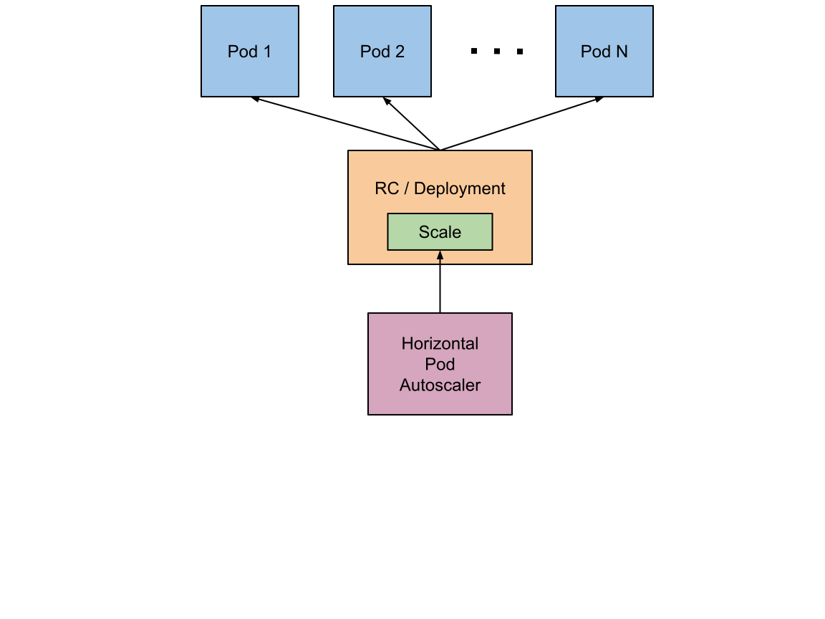
Horizontal Pod Autoscaler
The Horizontal Pod Autoscaler automatically scales the number of pods in a deployment or replica set based on observed CPU utilization.
It also supports scaling based on memory and custom metrics in the autoscaling/v2beta1 API version.

Slide 19
Horizontal Pod Autoscaler
How to create it?
CLI: kubectl autoscale deployment php-apache --cpu-percent=50 --min=1 --max=10
File: kubectl create -f hpa.yaml
apiVersion: autoscaling/v1 kind: HorizontalPodAutoscaler metadata: name: php-apache namespace: default spec: maxReplicas: 10 minReplicas: 1 scaleTargetRef: apiVersion: apps/v1 kind: Deployment name: php-apache targetCPUUtilizationPercentage: 50

Slide 20
Horizontal Pod Autoscaler
Demo
# Clone the metrics-server repo git clone https://github.com/kubernetes-incubator/metrics-server cd metrics-server # Deploy the metrics server kubectl create -f deploy/1.8+/

Slide 21
Horizontal Pod Autoscaler
Demo
# Create a deployment for a simple php-apache application kubectl run php-apache --image=k8s.gcr.io/hpa-example --requests=cpu=200m --expose --port=80 # Create Horizontal Pod Autoscaler kubectl autoscale deployment php-apache --cpu-percent=50 --min=1 --max=10 # Increase load kubectl run -i --tty load-generator --image=busybox /bin/sh while true; do wget -q -O- http://php-apache.default.svc.cluster.local; done # Check hpa and pod status kubectl get hpa -w kubectl get pods -w

Slide 22
IV - Jobs and initContainers

Slide 23
Jobs
What if you want to run an action and be sure it finishes successfully?
For example: Populate a database, download a dataset, …
A job creates one or more pods and ensures that a specified number of them successfully terminate

Slide 24
Jobs
apiVersion: batch/v1 kind: Job metadata: name: {{ template "fullname" . }}-seed-inception labels: app: {{ template "fullname" . }} chart: "{{ .Chart.Name }}-{{ .Chart.Version }}" release: "{{ .Release.Name }}" heritage: "{{ .Release.Service }}" spec: template: metadata: name: seed-inception spec: containers: - name: seed image: "{{ .Values.client.image.registry }}/{{ .Values.client.image.repository }}:{{ .Values.client.image.tag }}" imagePullPolicy: {{ .Values.client.image.pullPolicy | quote }} command: - "/bin/sh" - "-c" - | curl -o /seed/inception-v3-2016-03-01.tar.gz http://download.tensorflow.org/models/image/imagenet/inception-v3-2016-03-01.tar.gz cd /seed/ && tar -xzf inception-v3-2016-03-01.tar.gz rm inception-v3-2016-03-01.tar.gz inception_saved_model --checkpoint_dir=/seed/inception-v3 --output_dir=/seed/ rm -rf inception-v3 volumeMounts: - name: seed mountPath: /seed restartPolicy: Never
Full example in Tensorflow Inception chart

Slide 25

Jobs
And what if you want to run these actions time based?
For example if you want to run periodic backups of your database?
A Cron job manages time based Jobs:
Once at a specified point in time
Repeatedly at a specified point in time

Slide 26
initContainers
What if you want to run some actions everytime a new Pod is (re)scheduled?
For example:
Wait for a service to be created
Wait some time before start the main container
Clone a git repository into a volume
Generate a configuration file for the main application dynamically
We can use initContainers for those actions.
They always run to completion.
Each one must complete successfully before the next one is started.

Slide 27
initContainers
In use
apiVersion: v1 kind: Pod metadata: name: myapp-pod labels: app: myapp spec: containers: - name: myapp-container image: busybox command: ['sh', '-c', 'echo The app is running! && sleep 3600'] initContainers: - name: init-myservice image: busybox command: ['sh', '-c', 'until nslookup myservice; do echo waiting for myservice; sleep 2; done;'] - name: init-mydb image: busybox command: ['sh', '-c', 'until nslookup mydb; do echo waiting for mydb; sleep 2; done;']

Slide 28
Hands on!
Demo 2
Deploy bitnami/node chart and check initContainers usage

Slide 29
V - Pod patterns

Slide 30
Pod patterns
We have already seen several Kubernetes objects…
...let’s see know some good practices about pod patterns

Slide 31
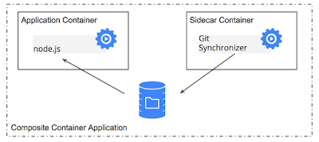
Pod patterns
Sidecar containers
Imagine I want to deploy a static application from a git repository with Nginx and update on every commit.
Sidecar containers extend and enhance the “main” container, they take existing containers and make them better
Possible because containers in the same pod shares the file system.

Slide 32
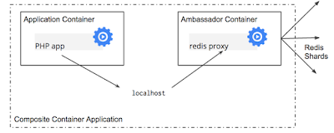
Pod patterns
Ambassador containers
Imagine I have a legacy application that I don’t own the code and it must to connect to redis on localhost. But I have an external redis service...
Ambassador containers proxy a local connection to the world
Possible because containers in the same pod shares network namespace.

Slide 33
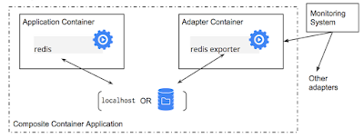
Pod patterns
Adapter containers
Imagine I have a Prometheus server expecting data in a specific format but I have several applications exporting data in several formats.
Adapter containers standardize and normalize output.
Possible because Pods shares network namespace and file system.

